Slide 1





UPS HA CREAT GGN 1054
Dec 2025
Classification: Internal

Slide 2
INJECTION MOULDING DIVISION
SMART APS
UNO MINDA RIKA PRIVATE LIMITED
V9
C1 Inventory Health — 5-Day Target System
C2 Priority Scoring — Urgency-First Planning
Advanced Planning &
Scheduling System
C3 22-Hour Daily Production Rule
C4 Specialised Machine Protection
Constraints & Solutions
C5 Same-Part Continuation & Changeover Minimisation
C6 Minimum Tools Principle
C7 Serial Tool-Changer Queue
C8 Minimum 4-Hour Run Block
C9 No Machine Sits Idle — 90% Floor
C10 Colour Grouping & Purge Management
Prepared by: Tushar (Intern) | Guided by: Mr. Amrit Lal | March 2026

Slide 3
WHAT THIS PRESENTATION COVERS
10 constraints — each explained with the problem it solves, the mechanism, and the flowchart
C1
Inventory Health
C6
Minimum Tools
5-Day target with safety floor & ceiling
1→2→3 tool escalation logic
C2
Priority Scoring
C7
Serial Tool-Changer
Urgency-first assignment, displacement pass
Structural no-overlap guarantee
C3
22-Hour Rule
C8
Minimum Run Block
Two-shift planning with hard ceiling
4-hour effective production floor
C4
Specialised Machines
C9
No Machine Idle
Part-count based machine ranking
90% utilisation enforcer — uncapped extension
C5
Same-Part Continuation
C10
Colour Grouping
Changeover minimisation & queue stagger
10-min purge penalty & colour-aware ranking
Smart APS V9 | Uno Minda Rika Private Limited | Injection Moulding Division

Slide 4
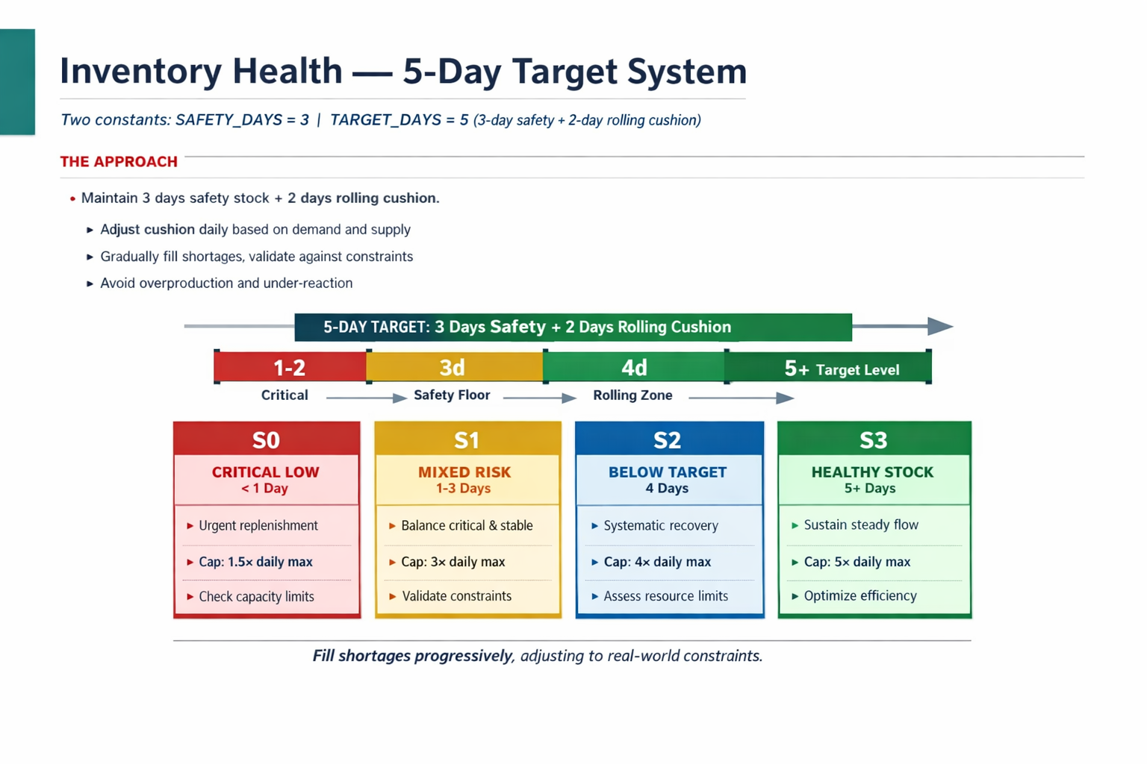
C1
Inventory Health — 5-Day Target System
Two constants: SAFETY_DAYS = 3 | TARGET_DAYS = 5
THE PROBLEM
S0
S1
S2
S3
Without scenario awareness, a day when all parts have 4-day stock is treated identically to a day when parts are at zero. This causes over-production during healthy periods and under-reaction during crises.
ALL critical
< 1 day
SOME critical
others have stock
ALL exist but
< 5-day target
ALL healthy
≥ 3-day safety
Build to 5-day target
urgent parts first
Critical → 5-day
Others maintain buffer
Fill to 5-day target
systematically
Produce 1×daily only
Skip parts at ≥5 days
5-DAY TARGET = 3 days buffer + 2 days safety cushion (covers days when a part cannot be planned)
Cap: 1.5× daily
Cap: 3× daily
Cap: 4× daily
Cap: 5× daily
0
1d
Critical
3d
Safety Floor
5d
Target
6d+
If fails → VT_Not_Planned | New: VT_Inventory_Target sheet shows every part vs 5-day ceiling with estimated days to reach target
Smart APS V9 | Uno Minda Rika Private Limited | Injection Moulding Division

Slide 5
C2
Priority Scoring — Urgency-First Assignment
Score 0–100 per part | Highest score gets a machine first
55%
URGENCY
25%
CATEGORY
20%
DAILY INDENT
Gap below 3-day safety floor
(SAFETY_DAYS = 3)
Zero below floor = 55 pts
Runner = 25 pts
Repeater = 15 pts
Stranger = 5 pts
Highest-demand part = 20 pts
Others scaled proportionally
Compute priority scores for ALL active parts
V9 NEW — DISPLACEMENT PASS (zero-inventory Runner / Repeater guarantee)
① Primary scheduling runs.
Zero-inv Runner / Repeater
still unscheduled?
② Find compatible machine
carrying part with MOST
days of stock ( ≥ 3 days )
③ Reduce that part's run by
MIN_RUN_HOURS.
Freed slot created.
④ Assign zero-inv part
to freed slot.
Guaranteed placement.
Sort parts: highest score first
Assign machines in score order
Safety rule: will NOT displace a part below its own 3-day safety floor. Cannot rob one crisis to fund another.
◆ Machine available for this part?
✗ VT_Not_Planned (score visible)
✓ Planned ✓
Smart APS V9 | Uno Minda Rika Private Limited | Injection Moulding Division

Slide 6
C3
The 22-Hour Daily Production Rule
2 shifts × 12h | 1h break each = 11h per shift = 22h per day
SHIFT 1 (12 hours)
SHIFT 2 (12 hours)
PRODUCTION — 11 hours
BRK
PRODUCTION — 11 hours
BRK
Machine starts the day with
22 hours available
Each part assigned:
Deducts Run Time + CO Time
Hours remaining checked
before every new assignment
◆ Does the part fit within remaining hours?
✓ Added to plan ✓
✗ → VT_Not_Planned with exact free-hours map
Key formulas: Rate = 3600 ÷ cycle_time (pcs/hr) | Daily Indent = Monthly Indent ÷ Working Days | Working Days = Calendar Days − Sundays
Smart APS V9 | Uno Minda Rika Private Limited | Injection Moulding Division

Slide 7
C4
Specialised Machine Protection
Part-Count ranking — most constrained machine gets its parts first
Machine
Part Count
Compatible Parts
Ranking Score
Assigned First?
M3
2
Part A, Part B
0.13 (lower = better)
✅ YES — FIRST
SPECIALISED
M2
8
Part A, B, C, D, E, F, G, H
0.53 (lower = better)
2nd
M1
15
Part A–O (15 parts compatible)
1.00 (lower = better)
3rd
Part needs a machine → list compatible machines
Sort by Part_Count ascending
(fewest-parts machine = rank 1)
Assign to rank-1 machine
(most constrained first)
Remaining machines stay free
for their dedicated parts
⚠
If Machine is Full
📋
VT_Machine_Part_Count Sheet
If even the specialised machine is full and its dedicated part cannot be planned, the part appears at the top of VT_Not_Planned. The planner can free hours by reducing a lower-priority part.
Source data: column 'Machine' and 'Part_Count'. Loaded at startup. max_part_count drives the normalisation. Missing data defaults to equal ranking for all machines.
count_score = part_count ÷ max_part_count | Lower count = stronger preference | M3 protected before M1 can take any work
Smart APS V9 | Uno Minda Rika Private Limited | Injection Moulding Division

Slide 8
C5
Same-Part Continuation & Changeover Minimisation
machine_state.json | Serial queue | Quantity stagger — 20-min post-finish buffer
🟢 CASE 1 — Same Part
🔵 CASE 2 — Diff Part, Same Colour
🟡 CASE 3 — Diff Part, Diff Colour
Mould:
Already loaded
Mould:
Change needed
No purge
Mould:
Change + 10-min purge
While waiting:
None
While waiting:
Short (queue position 1–3)
While waiting:
Longer (queue position 4+)
New part qty:
Based on full 22h
New part qty:
22h minus wait time
New part qty:
22h minus longer wait
CHANGEOVER QUEUE — HOW IT WORKS
End of day:
Save last part per
machine → JSON
Next day:
Prefer same-machine
for each part
Unavoidable COs
joined to serial
tool-changer queue
Queue sorted by
natural_start time
ascending
Each CO: actual_start =
max(natural, free_at)
free_at advances
Machine waits?
Extend previous
part's run to fill
Quantity stagger rule: required_gap = CO_duration + 20 min. If two COs would finish within that gap, PUSH: add qty to later machine (free production). If push exceeds OPD cap, PULL: reduce earlier machine's qty (never below daily indent).
Smart APS V9 | Uno Minda Rika Private Limited | Injection Moulding Division

Slide 9
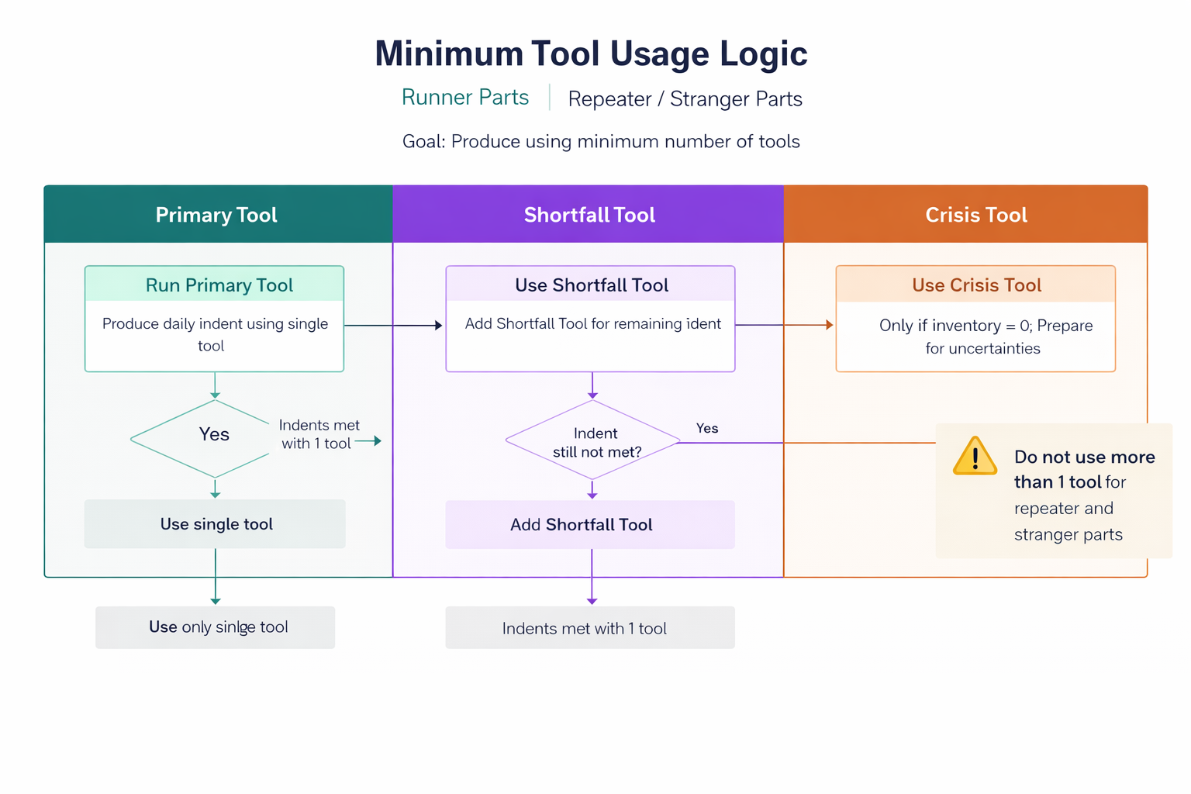
C6
Minimum Tools Principle
Tool 1 always first | Tool 2 only for shortfall | Tool 3+ only at zero inventory
PHASE 1 — Primary Machine
PHASE 2 — Tool Expansion
PHASE 3 — Inventory Build
Run Tool 1 up to capacity.
Target: cover full daily indent.
Shortfall remains?
Add Tool 2 for shortfall only.
(Normal: max 2 tools)
Indent covered?
Extend same machines to build
inventory toward 5-day target.
◆ Tool 1 alone covers full daily indent?
◆ Shortfall covered after Tool 2?
✓ YES → Stop. 1 tool used. Phase 3 builds buffer.
✓ YES → Stop. 2 tools used. Gap reported in VT_Production_vs_Indent.
Tool 3+ — CRISIS ONLY
A third (or more) tool is only permitted when: (a) inventory = ZERO AND (b) Tools 1 + 2 together still cannot cover the shortfall. Any use of 3+ tools is flagged in the console with tag [CRISIS — 3rd+ tool]. Under normal operations this tag should never appear.
Smart APS V9 | Uno Minda Rika Private Limited | Injection Moulding Division

Slide 10
C7
Serial Tool-Changer Queue — No-Overlap Guarantee
Structural guarantee — not an optimisation — overlap is physically impossible
THE PROBLEM
SERIAL QUEUE MECHANISM
One tool-change team for 30 machines. If 5 machines need COs at the same time, 4 machines sit idle waiting. Previous CSP solver hung the system with 20+ events.
1
Collect all CO events from the plan
2
Sort by natural_start time ascending
EXAMPLE TIMELINE — 4 machines, 4 COs
3
Walk through one by one
M1
4
actual_start = max(natural_start, free_at)
CO
RUN
5
free_at = actual_start + CO_duration
M2
wait
CO
RUN
6
Machine waits? Extend previous part's run
M3
wait
CO
RUN
M4
wait
CO
RUN
Time → | No two CO bars overlap. | Waiting time filled with extended production.
GUARANTEE: Because free_at only ever moves FORWARD, actual_start ≥ free_at always. Two changeovers cannot overlap — this is enforced by the data structure, not by a solver or time limit. Performance: O(n log n). No system hangs regardless of CO count.
Smart APS V9 | Uno Minda Rika Private Limited | Injection Moulding Division

Slide 11
C8
Minimum 4-Hour Run Block
Changeover overhead must be justified by sufficient run time
WITHOUT 4-HOUR RULE — wasteful
Machine has remaining free hours
CO 40m
Run
1.5h
WASTED — machine idle (40 min CO for 1.5h production is 36% overhead)
Subtract CO time from remaining hours
WITH 4-HOUR RULE — efficient
CO 40m
RUN ≥ 4 hours (CO overhead = 14% — acceptable)
◆ Effective free time ≥ 4 hours?
NO → Skip this machine.
Try next compatible machine.
effective_free = remaining − CO_hours
Rule: effective_free ≥ MIN_RUN_HOURS (4.0h) | Applied at every assignment — primary, enforcer, filler, skipped parts
✓ Assign part. Run begins after CO. ✓
Exception — 90% Floor Extension (Constraint 9):
When a machine is below the 90% utilisation floor and remaining time is less than 4 hours, the system extends the already-running part without requiring the 4-hour minimum. This is the only permitted exception. It is tagged +Floor90 in the output.
Smart APS V9 | Uno Minda Rika Private Limited | Injection Moulding Division

Slide 12
C9
No Machine Sits Idle — 90% Utilisation Floor
5-step enforcer | Step 0 fires below 90% floor | Uncapped extension
22 HOURS AVAILABLE PER MACHINE PER DAY
90% floor
PLANNED PRODUCTION (90% floor = 19.8h)
2.2h max idle
★ V9 NEW
STEP 0
90% FLOOR
Extension
STEP 1
NORMAL
Extension
STEP 2
ADD NEW
PART
STEP 3
RE-RUN
SPARE TOOL
STEP 4
SKIPPED
PART
Below 90%?
Extend existing parts
NO inventory cap
NO 4h minimum
OPD-capped extension
of existing parts
Highest priority first
Unplanned compatible
part with demand.
Colour-aware sort.
Already-planned part
with spare tool
available.
Last resort.
Previously skipped part
(low indent/trivial).
✓ Step 5 — LOG MICRO-IDLE:
If all 5 steps exhausted and machine still has ≥ 0.25h idle time below 90% floor → logged in VT_Micro_Idle sheet with exact reason. Management has full visibility of why the machine could not be filled.
Smart APS V9 | Uno Minda Rika Private Limited | Injection Moulding Division

Slide 13
C10
Colour Grouping & Purge Management
Loaded from Color column in VT sheet | 10-minute purge penalty for colour change
🟢 Same Part
🔵 Diff Part — Same Colour
🟡 Diff Part — Diff Colour
CO Time: 0 minutes
CO Time: Normal CO only
CO Time: Normal CO + 10 min purge
Mould loaded. Start immediately.
Mould changes, colour same. No barrel purge required.
Residual colour must be purged before new run.
MACHINE RANKING COST — HOW COLOUR FITS IN
-0.15
Same part as last run (zero CO)
Strongest preference. Mould loaded, start immediately.
-0.08
Different part, same colour (no purge)
Strong preference. CO needed but colour purge avoided.
0.00
Different part, different colour
Standard. CO + 10-min purge added to changeover time.
COLOUR IN ALL OUTPUT SHEETS — added columns:
Color (part colour)
Color_Purge (Yes/No)
Color_Before / Color_After
Color_Change (YES—PURGE)
Colors_Today (machine util)
Color_Purges (count per machine)
v
Smart APS V9 | Uno Minda Rika Private Limited | Injection Moulding Division

Slide 14
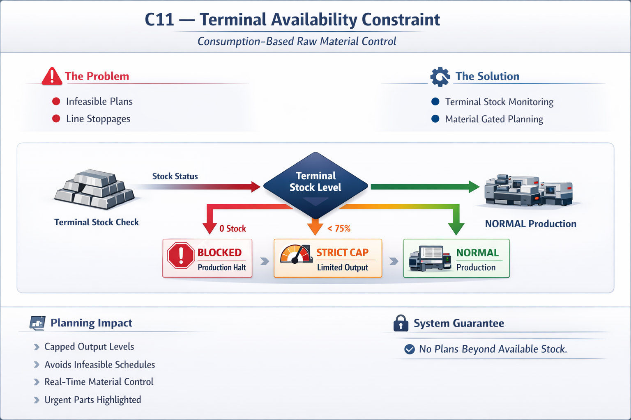
C11
Smart APS V9 | Uno Minda Rika Private Limited | Injection Moulding Division

Slide 15
ALL 10 CONSTRAINTS — QUICK REFERENCE
Problem • Solution • Fallback — one line per constraint
C1
Inventory Health
5-day target (SAFETY=3, TARGET=5). Scenario S0–S3 sets production qty.
VT_Not_Planned | VT_Inventory_Target sheet
C2
Priority Scoring
Score 0–100 per part. Urgency vs 3-day floor. Highest assigned first. Displacement for zero-inv R/R.
VT_Not_Planned (score visible at top)
C3
22-Hour Rule
Hard ceiling. CO time + run time ≤ remaining hours. Applied before every assignment.
VT_Not_Planned with free-hours map
C4
Specialised Machines
Part_Count ranking: fewest-parts machine first. Guarantees constrained machines are served first.
VT_Not_Planned if specialised machine full
C5
Same-Part Continuation
Save state daily. Prefer same machine. Queue stagger: req_gap = CO_dur + 20 min. Push/Pull qty.
CO charged + sequenced by tool-changer queue
C6
Minimum Tools
Tool 1 first. Tool 2 only for shortfall. Tool 3+ only at zero inventory. Tagged [CRISIS] in console.
VT_Production_vs_Indent shows gap
C7
Serial Tool-Changer
Structural no-overlap: free_at moves forward only. 20-min post-finish buffer. Extend run for wait.
No fallback — overlap structurally impossible
C8
Minimum Run Block
effective_free ≥ 4h after CO. Exception: Step 0 Floor90 extension below 90% (no minimum needed).
VT_Not_Planned — next machine tried first
C9
No Machine Idle 90%
Step 0 uncapped extension below 90% floor. Steps 1–4 fill remaining time.
VT_Micro_Idle with reason if all steps exhausted
C10
Colour Grouping
Colour-aware ranking (−0.08 same colour). 10-min purge in CO time. Colour in all output sheets.
Purge time added; included in 22h budget
Smart APS V9 | Uno Minda Rika Private Limited | Injection Moulding Division

Slide 16
SMART APS V9 — WHAT IT DELIVERS
Prepared by Tushar (Intern) | Guided by Mr. Amrit Lal | Uno Minda Rika Private Limited
< 60s
10
≥ 90%
0
5 days
NIL
Plan generated
every day
Constraints
enforced
Machine utilisation
floor guaranteed
CO overlaps
possible
Inventory target
(3 buffer + 2 safety)
Software licence
cost
📊
14 Output Sheets
🎨
Colour Constraint
VT_Plan_By_Machine, VT_CO_Queue, VT_Inventory_Target, VT_Priority_Scores, VT_Micro_Idle and more — every decision is auditable.
Colour-aware ranking, 10-min purge in CO time, colour tracked in every output sheet. Minimises purge time automatically.
🔒
Zero-Overlap Guarantee
🏭
Displacement Pass
Serial queue — free_at cursor only moves forward. Overlap is structurally impossible, not just improbable.
Zero-inventory Runners and Repeaters always get a machine slot, even if it means reducing the least-urgent planned part.
Smart APS V9 • Constraints & Solutions • Uno Minda Rika Private Limited • March 2026

Slide 17






Thank You
Corporate Office
Address: Village Nawada Fatehpur,
P.O. Sikanderpur Badda, Manesar, Gurgaon – 122004, India.
Website: www.unominda.com
Email ID:
Follow us on social media. Links below
Classification: Internal

